Slide 1
Merry Christmas
For a year like 2024 2025

Slide 2
Game: Guessing songs

Slide 3
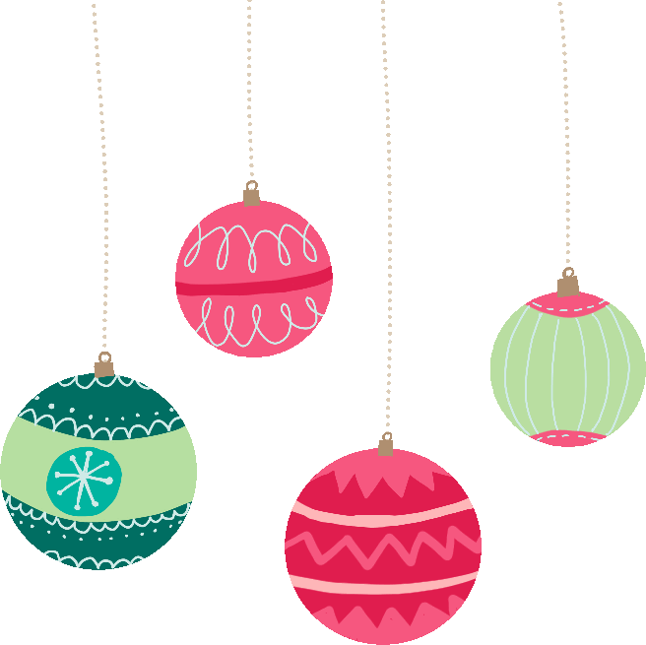
Note: Click the icon to reveal answers.
 | Snowman - Sia
 | Santa Tell Me - Ariana Grande
 | All I want for Christmas is you
 | Hallelujah
 | The Man with the Bag
 | Here comes Santa Claus

Slide 4
 | Mistletoe - Justin Bieber
 | Feliz Navidad
 | Santa Claus is coming to town
 | Last Christmas
 | Winter Wonderland
 | Holly Jolly Christmas
Note: Click the icon to reveal answers.

Slide 5
Vocabulary

Slide 6
Compassionate
Feeling or showing concern for others.
Overwhelmed
Elated
Feeling an intense amount of emotion.
Extremely happy and thrilled.
Feelings & Emotions
in Christmas
Joyful
Tender
Feeling or expressing great happiness and delight.
Showing gentleness and affection.
Grateful
Feeling or showing thanks and appreciation.
Loving
Feeling or showing deep affection.
Content
Feeling satisfied and at ease.
Festive
Nostalgic
Cheerful and celebratory, especially related to a holiday.
Feeling sentimental about the past.

Slide 7
Discussions

Slide 8
What is your favorite Christmas song?
Are there any special songs in your country that you don't hear here?

Slide 9
Do you attend any special religious ceremonies during the Christmas season?
Do you celebrate Christmas in your country?

Slide 10
Is there a holiday similar to Christmas in your home country?

Slide 11
Is your Christmas tree a real tree or an artificial tree?

Slide 12
What is the weather like in your country around Christmas time?

Slide 13
What kind of interesting things do you do for Christmas in your home country?

Slide 14
What is your attitude toward the commercialization of the Christmas season?
Is Christmas becoming too commercialized?

Slide 15
Merry Christmas
& Happy New Year!

