Slide 1

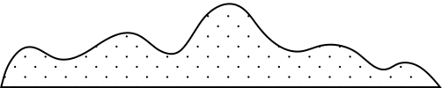
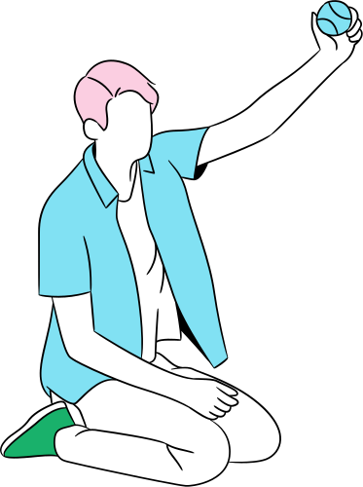
THIS WEEK’S TOPIC
Practicing Self-Care

Slide 2




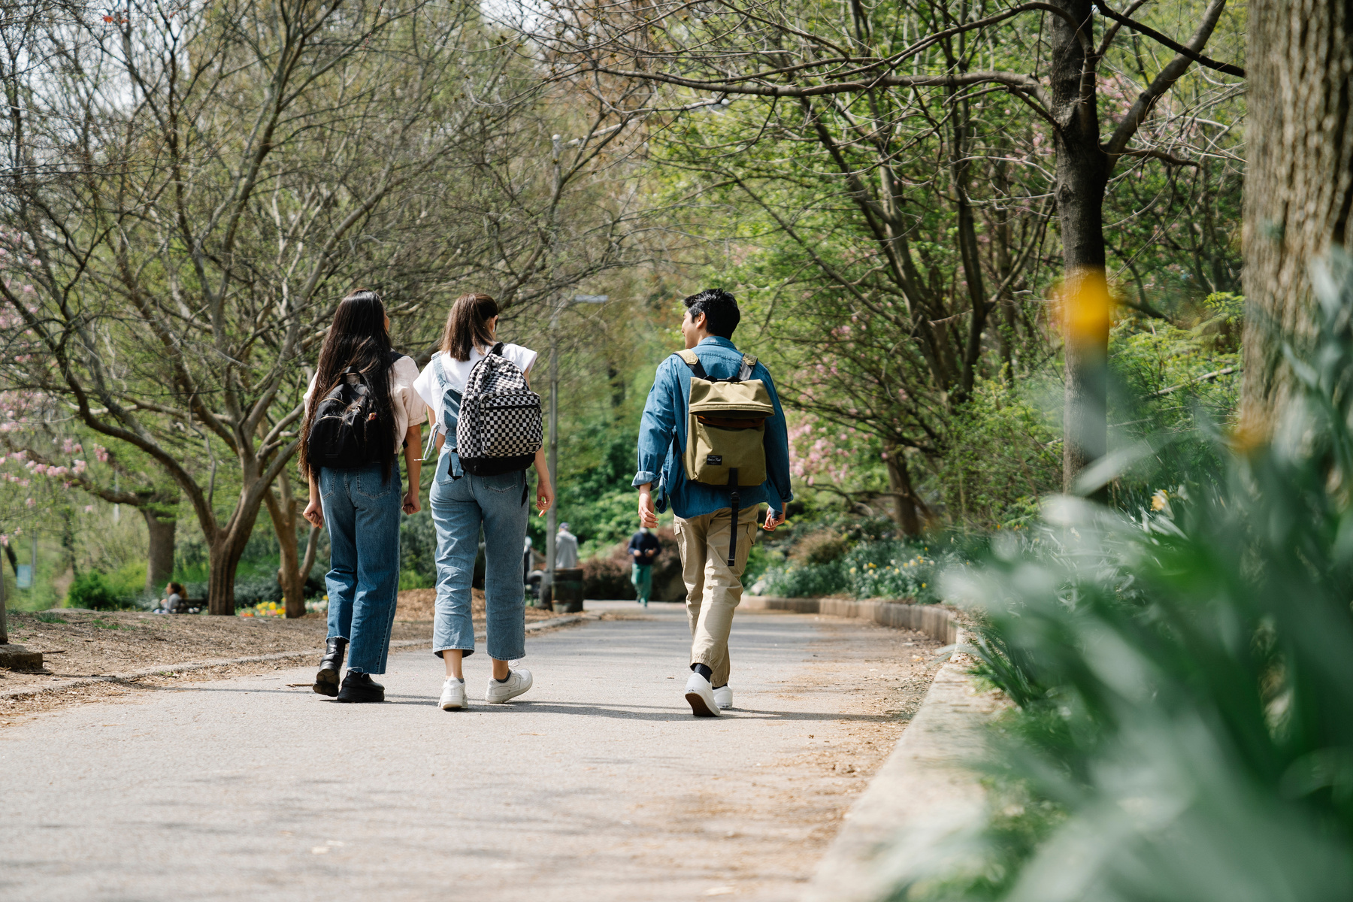

“What do you see?”
“Which one do you like doing?”

Slide 3

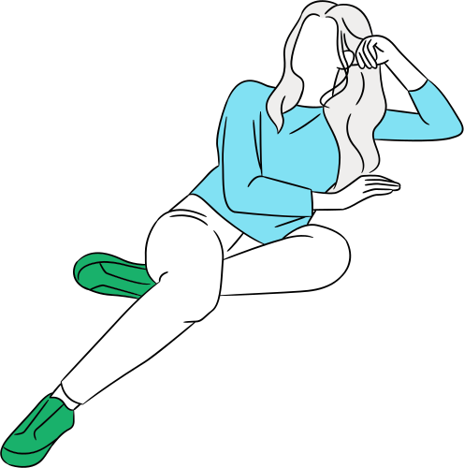

Quick poll: “How do you take care of yourself?”

Slide 4



What is self-care?
Self-care is any activity we actively choose to do to take care of our physical, mental and emotional well-being.

Slide 5
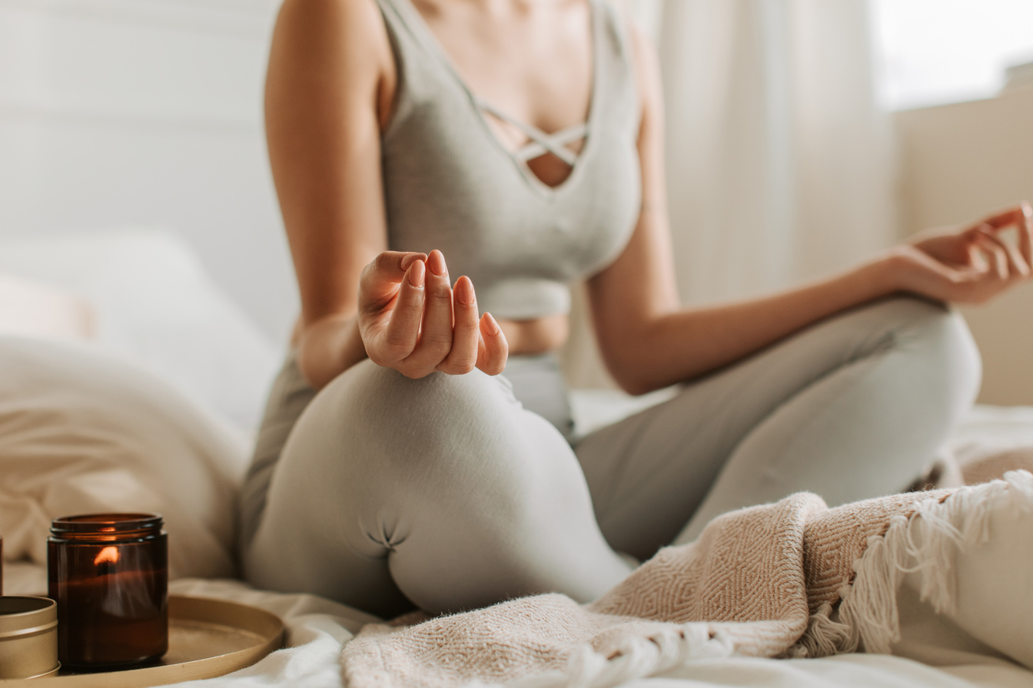
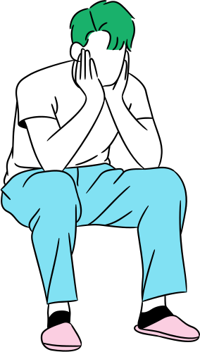
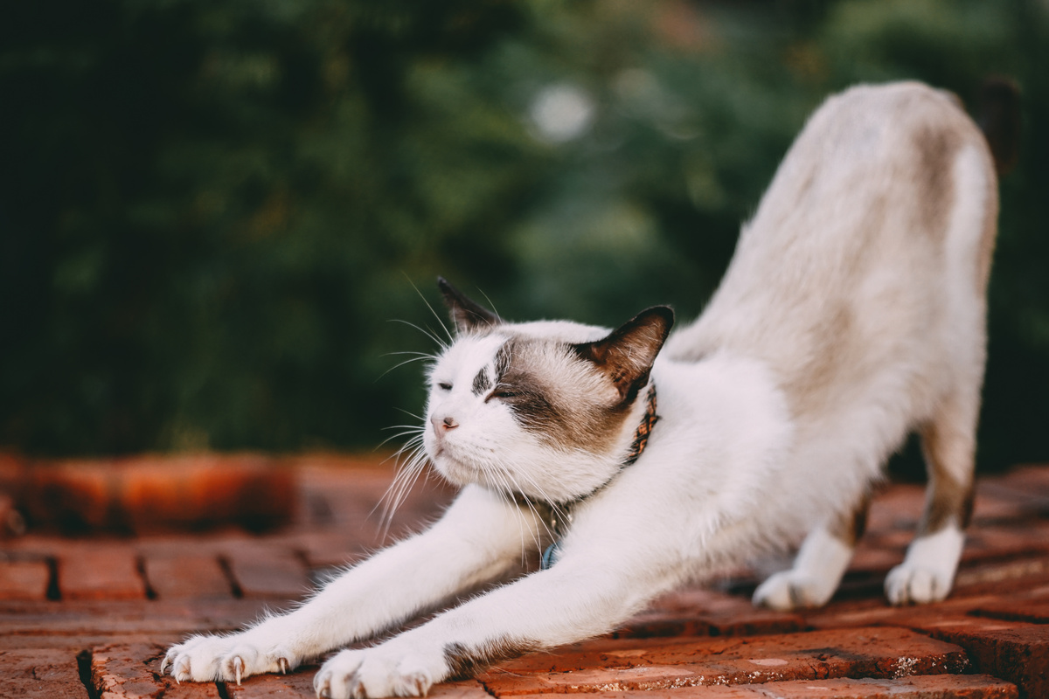
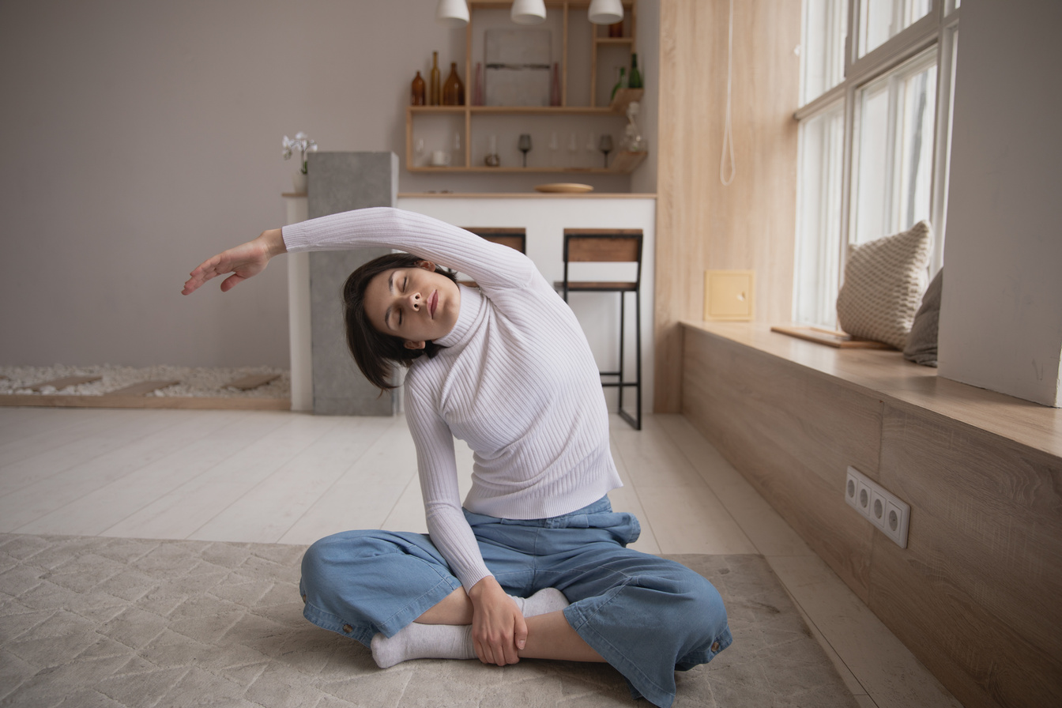

Vocabulary
Recharge
👉 To get your energy back; feel better after resting
🗣️ Example: “I need to sleep early to recharge for tomorrow.”
Meditate
👉 To sit quietly, breathe, and clear your mind
🗣️ Example: “My sister meditates every morning to feel peaceful.”
Stretch
👉 To move your body to make your muscles longer and feel relaxed
🗣️ Example: “I stretch in the morning to wake up my body.”
Journal
👉 To write your thoughts or feelings in a notebook
🗣️ Example: “I journal when I feel sad or worried.”

Slide 6



Why do we need to practice self-care?
Our well-being is important no matter the circumstance or state of the world.
Self-care helps us manage stress better and allows us to be more productive. Taking care of ourselves helps us keep a good work-life balance.

Slide 7

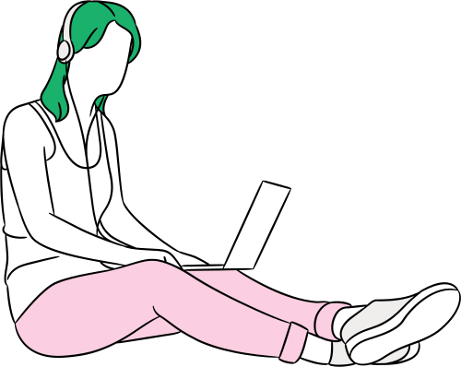
1)
Set a routine. Schedule time for online classes as well as time for reviewing lessons and doing homework.
2)
Take breaks during the day. Take the time to go offline and do other things not related to classes.
Mental Self-Care
3)
Practice mindfulness and take time for mentally-relaxing activities as well as activities that stimulate your creativity.
Taking care of your mind

Slide 8
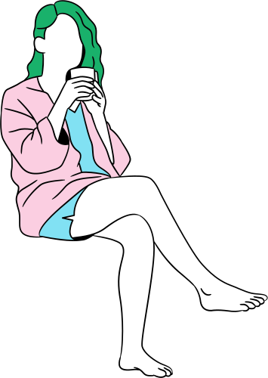
Physical Self-Care
Get enough sleep
Keep a bedtime schedule to give your body
the rest it needs to recover.
Eat well and eat healthy
Nourish your body with healthy food
and keep yourself hydrated.
Exercise regularly
Set aside at least 30 minutes a day to workout
or to simply move your body.

Slide 9


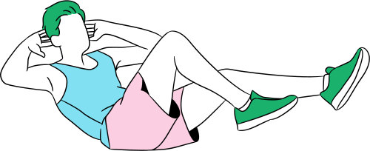
You can also think of self-care as taking care of yourself so you can better take care of others.
What are ways you use to self-care?

Slide 10
Game: Wheel of Speaking
https://wordwall.net/resource/90364287

Slide 11
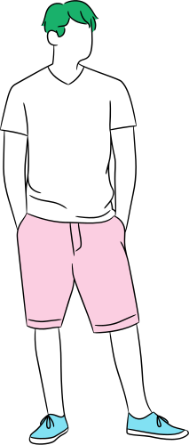


Reflection
“What new word did you learn today?”
“What is one self-care tip you will try this week?”
Encourage student to state a “Self-care goal”
(e.g., sleep early 3 times a week)

Slide 12
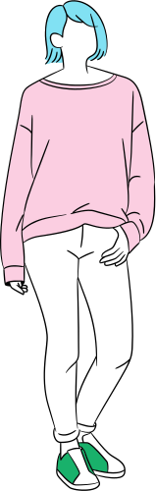

See you later!
Thank you!

